Slide 1
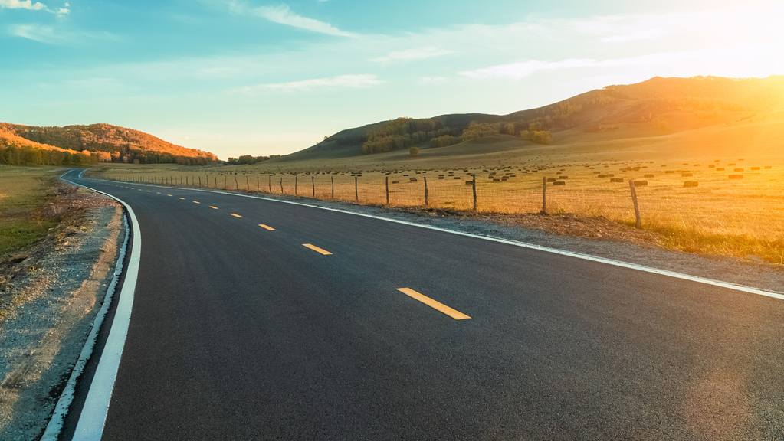
Personalized Travel Planning and Tracking App
Done by:
Boopathy H
Balaji R
Pranesh S
Vaitheeshwaran S

Slide 2
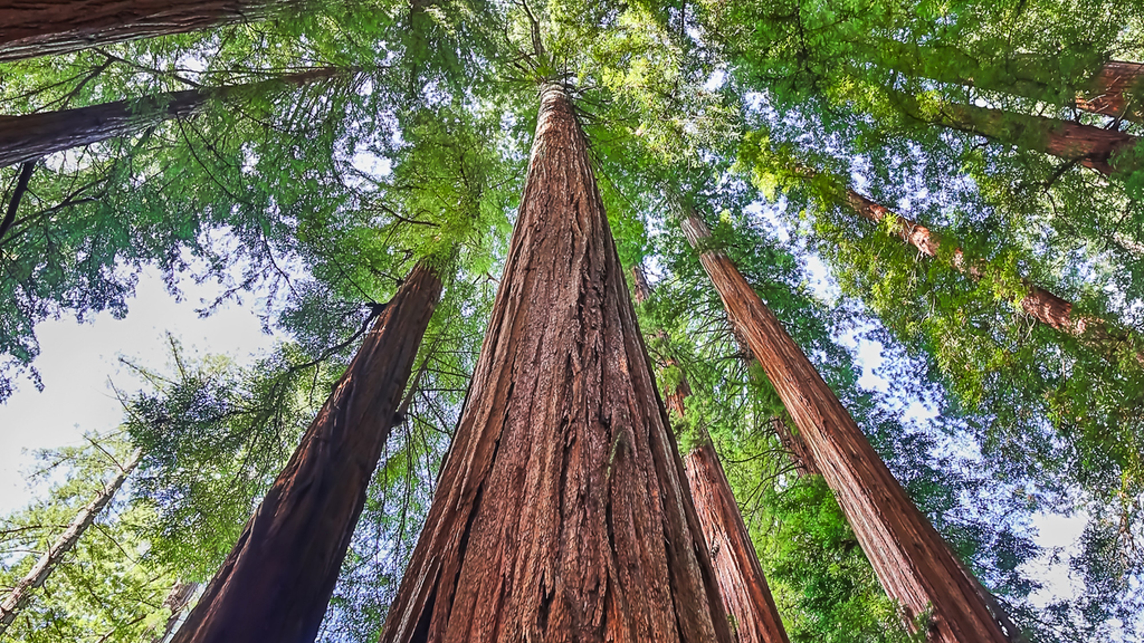
Projectdescription: This personalized travel planning and tracking app is a purpose-built mobile application focused on delivering only the most relevant and essential information to travelers. By filtering out extraneous details, the app provides an efficient and highly tailored travel experience, from planning to real-time tracking. Key features include a customizable itinerary builder, where users can outline their travel schedule, track reservations, and add important reminders. The app also offers real-time updates on factors such as flight delays, weather conditions, and traffic changes, ensuring that users have access to crucial, actionable information at all times. To support financial planning, the app incorporates an expense tracker that highlights key spending insights, helping users maintain budget control effortlessly. With personalized recommendations driven by user profiles and preferences, the app surfaces only the most relevant travel options, enhancing convenience while avoiding information overload. Offline accessibility for essential travel details—such as itinerary, tickets, and maps—ensures seamless operation even in remotelocations. This app is designed for today’s traveler who values efficiency, customization, and a focus on essential information, helping users stay informed and prepared without distraction.

Slide 3
Main activity.java import android.content.Contextimport android.content.Intent import android.os.Bundleimport androidx.activity.ComponentActivity import androidx.activity.compose.setContent import androidx.compose.foundation.Image import androidx.compose.foundation.clickable import androidx.compose.foundation.layout.* import androidx.compose.foundation.rememberScrollState import androidx.compose.foundation.verticalScroll import androidx.compose.material.Card import androidx.compose.material.Text import androidx.compose.runtime.Composable import androidx.compose.ui.Alignment import androidx.compose.ui.Modifier import androidx.compose.ui.draw.scale import androidx.compose.ui.graphics.Color import androidx.compose.ui.res.painterResource import androidx.compose.ui.res.stringResource

Slide 4
import androidx.compose.ui.text.font.FontFamily import androidx.compose.ui.text.font.FontWeight import androidx.compose.ui.text.style.TextAlign import androidx.compose.ui.unit.dp import androidx.compose.ui.unit.sp class MainActivity : ComponentActivity() { override fun onCreate(savedInstanceState: Bundle?) { super.onCreate(savedInstanceState) setContent { TravelApp(this) } } @Composable fun TravelApp(context: Context) { Column (modifier = Modifier

Slide 5
.padding(20.dp)
.verticalScroll(rememberScrollState())
) {
Text(
fontSize = 40.sp,
color = Color(android.graphics.Color.rgb(120, 40, 251)),
fontFamily = FontFamily.Cursive,
text = "Wanderlust Travel“
)
Spacer(modifier = Modifier.height(20.dp))
// 01
Card(
modifier = Modifier
.fillMaxWidth()
.height(250.dp)
.clickable {

Slide 6
context.startActivity(
Intent(context, BaliActivity::class.java)
)
},
elevation = 8.dp
)
{
Column(
horizontalAlignment = Alignment.CenterHorizontally
) {
Image(
painterResource(id = R.drawable.bali), contentDescription = "", modifier = Modifier
.height(150.dp)
.scale(scaleX = 1.2F, scaleY = 1F)
)

Slide 7
Text(
text = stringResource(id = R.string.place_1),
fontSize = 18.sp
)
Text(
text = stringResource(id = R.string.description),
fontWeight = FontWeight.Light,
fontSize = 16.sp,
textAlign = TextAlign.Center,
)
Text(
text = stringResource(id = R.string.plan), color = Color.Gray,
fontSize = 16.sp
)
}
}

Slide 8
spacer(modifier = Modifier.height(20.dp))
//02
Card(
modifier = Modifier
.fillMaxWidth()
.height(250.dp)
.clickable {
context.startActivity(
Intent(context, ParisActivity::class.java)
)
},
elevation = 8.dp
)
{
Column(
horizontalAlignment = Alignment.CenterHorizontally
)

Slide 9
{
Image(
painterResource(id = R.drawable.paris), contentDescription = "", modifier = Modifier
.height(150.dp)
.scale(scaleX = 1.2F, scaleY = 1F)
)
Text(
text = stringResource(id = R.string.place_2),
fontSize = 18.sp
)
Text(
text = stringResource(id = R.string.description),
fontWeight = FontWeight.Light,
fontSize = 16.sp,
textAlign = TextAlign.Center,
)

Slide 10
Text( text = stringresource(id = R.String.Plan), color = color.Gray, fontsize = 16.Sp ) } } spacer(modifier = modifier.Height(20.Dp)) //03 Card( modifier = Modifier .fillMaxWidth() .height(250.dp) .clickable { context.startActivity( Intent(context, SingaporeActivity::class.java) ) },

Slide 11
elevation = 8.Dp ) { column( horizontalalignment = alignment.Centerhorizontally ) { image( painterresource(id = R.Drawable.Singapore), contentdescription = "", modifier = modifier .Height(150.Dp) .Scale(scalex = 1.2F, scaley = 1F) ) Text( text = stringResource(id = R.string.place_3), fontSize = 18.sp )

Slide 12
Text( text = stringresource(id = R.String.Description), fontweight = fontweight.Light, fontsize = 16.Sp, textalign = textalign.Center, ) Text( text = stringresource(id = R.String.Plan), color = color.Gray, fontsize = 16.Sp ) } } spacer(modifier = modifier.Height(20.Dp)) } } }

Slide 13
Manifest program: <?Xml version="1.0" encoding="utf-8"?><Manifest xmlns:android="http://schemas.Android.Com/apk/res/android" xmlns:tools="http://schemas.Android.Com/tools"> <application android:allowbackup="true" android:dataextractionrules="@xml/data_extraction_rules" android:fullbackupcontent="@xml/backup_rules" android:icon="@mipmap/ic_launcher" android:label="@string/app_name" android:roundicon="@mipmap/ic_launcher_round" android:supportsrtl="true" android:theme="@style/theme.Teamproject" tools:targetapi="31"> <activity android:name=".Mainactivity" android:exported="true"

Slide 14
android:label="@string/app_name" android:theme="@style/theme.Teamproject"> <intent-filter> <action android:name="android.Intent.Action.MAIN" /> <category android:name="android.Intent.Category.LAUNCHER" </intent-filter> </activity> </application> </manifest>

Slide 15
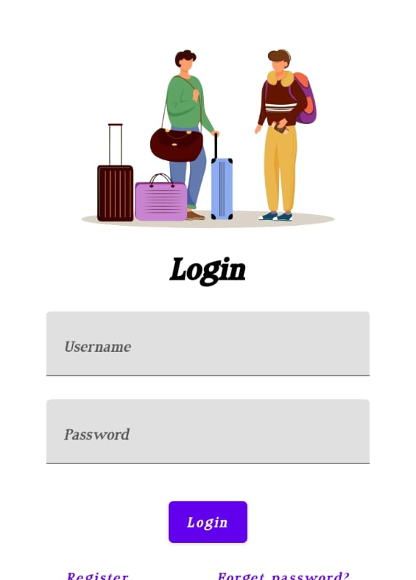
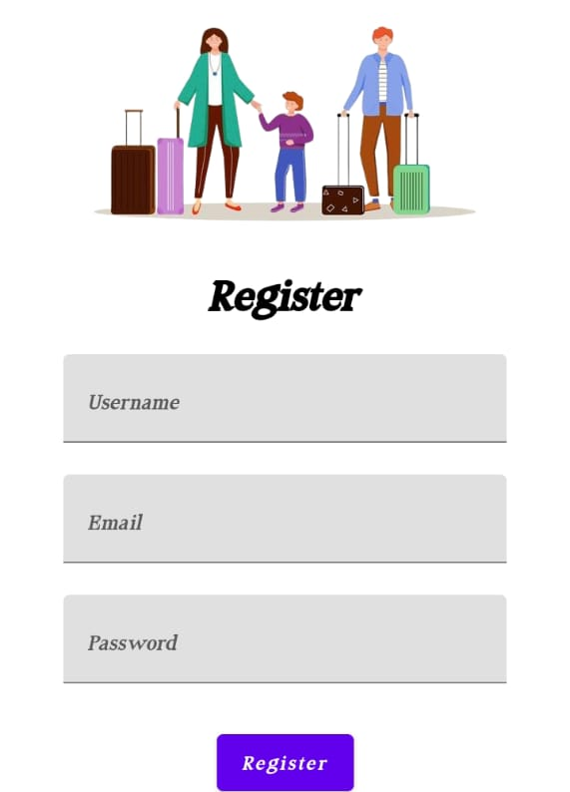
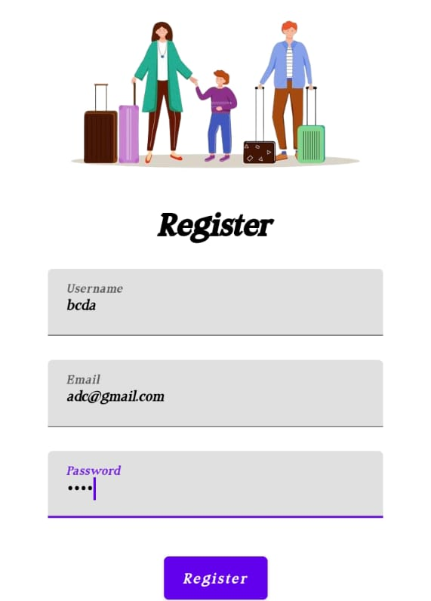
output

Slide 16

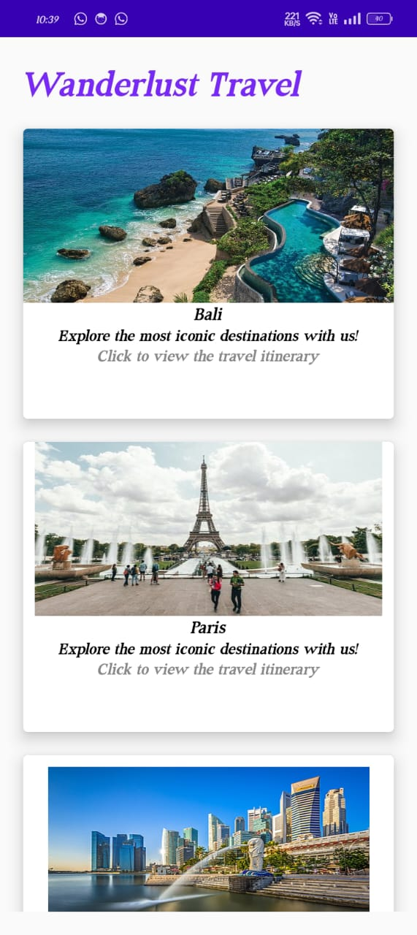
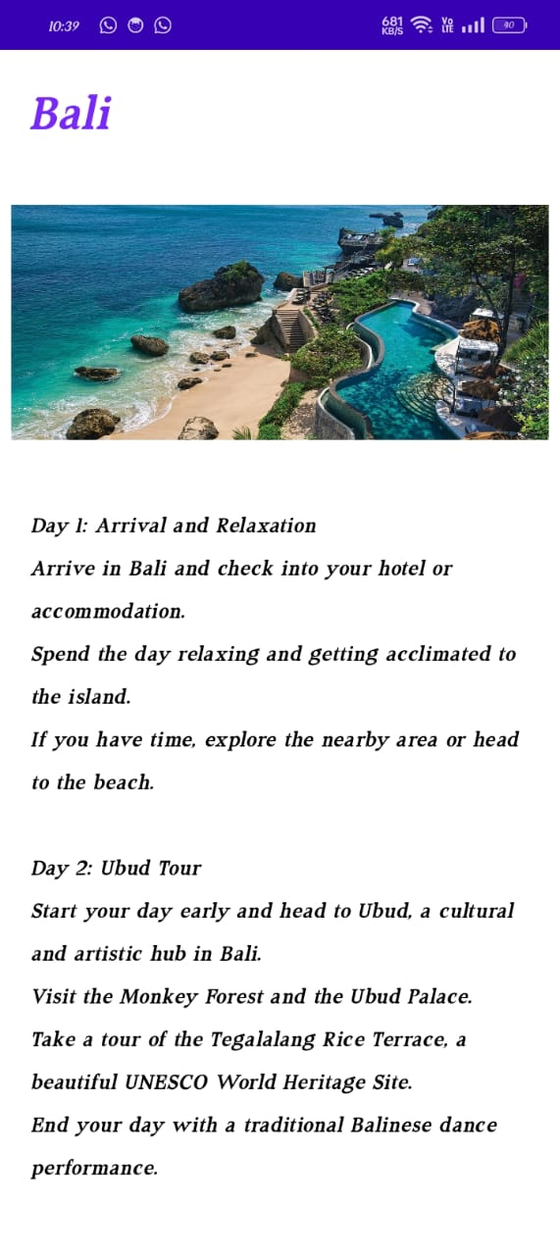
output

Slide 17
Thank you

